Slide 1
NAME : ANUSUYA .B COURSE : ADVANCED CERTIFICATION IN SOFTWARE TESTING BATCH : 2022-8955 ENROLLMENT NUMBER : EBEONO223747633 TRAINER : LEENA THORAT

Slide 2
Agenda
01 Pseudo code & Algorithm
02 Software Engineering
03 SDLC
04 SQL
05 STLC
06 Manual Testing
07 Java
08 Selenium Webdriver
09 TDD & BDD
10 Introduction to Website
11 Project Details

Slide 3
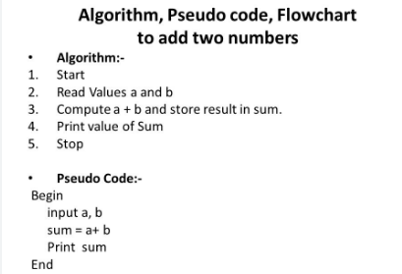
Pseudo code & Algorithm

Slide 4
Software Engineering
Software Evolution Characteristics of
Good Software
S-type Operational
P-type Transitional
E-type Maintanence

Slide 5
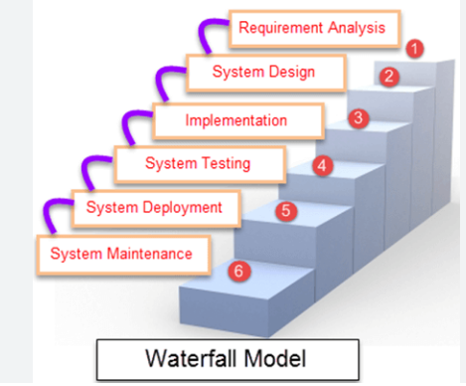
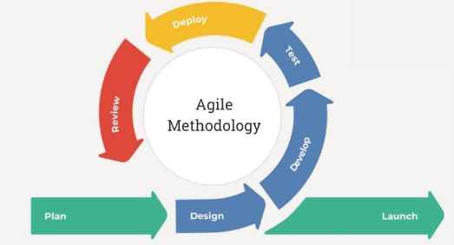
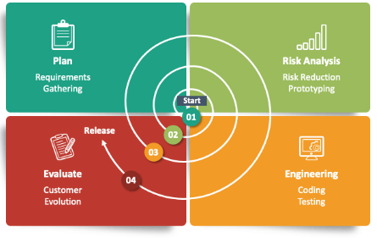
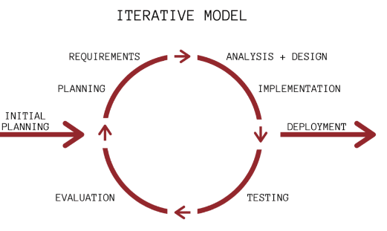
SDLC
.

Slide 6
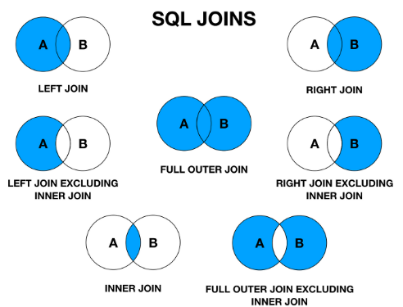
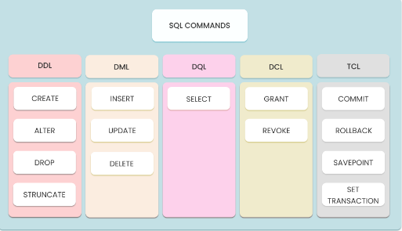
sql
.

Slide 7
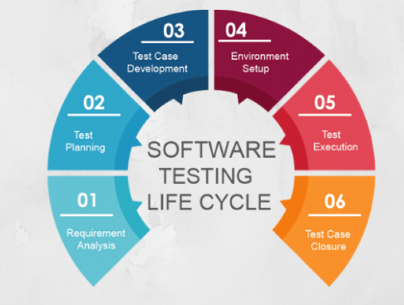
STLC

Slide 8
Manual Testing
Functional Testing
Non-Functional Testing
Regression Testing
White Box Testing
Black Box Testing
Exploratory Testing
Sanity Testing
Smoke Testing
Performance Testing
Security Testing
Verification and Validation

Slide 9
JAVA
Variables
Operators
Decision Making Statements
Loops
Oops Concepts
Exception Handling

Slide 10
SELENIUM WEBDRIVER
Find Element
Send Keys
Select Class
Action Class
Drop Down
Drag And Drop
Alert
Waits
Check Box
Radio Button

Slide 11
TDD & BDD
Maven
TestNg
Detailed Report
Cucumber
Feature File

Slide 12

Introduction Of Website

Slide 13
PROJECT DETAILS
1
Programming Language - Java
2
Automation Technology - Selenium Webdriver
3
Plugin - Xpath Finder
Tools - Eclipse
4
5
Driver – Crome Driver

Slide 14
Thank you

Slide 15






Alternative resources

